Slide 1


Slide 2

Intro
A Modern Solution to Outdated Comparison Tools
Access to multiple retailers & sellers of tyres all on 1 website
Compare All of their information, without needing to create accounts on all the websites
Honest and up to date pricing; no need to worry about fake sale
Dedicated tire search & filter tools To find tyres that fit your car’s model, year, and needs
As a seller you can get real time analytics on what your clients are looking for most to prepare your own stock
We care for your privacy

Slide 3
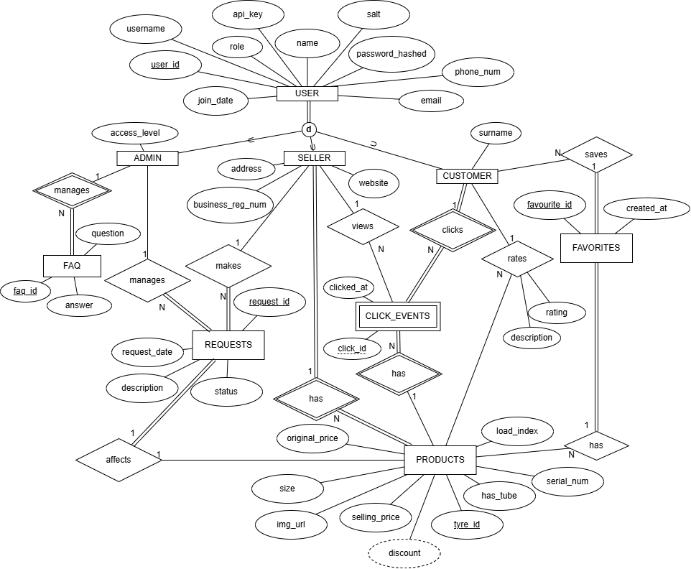
Task 2: Our ER Diagram

Slide 4
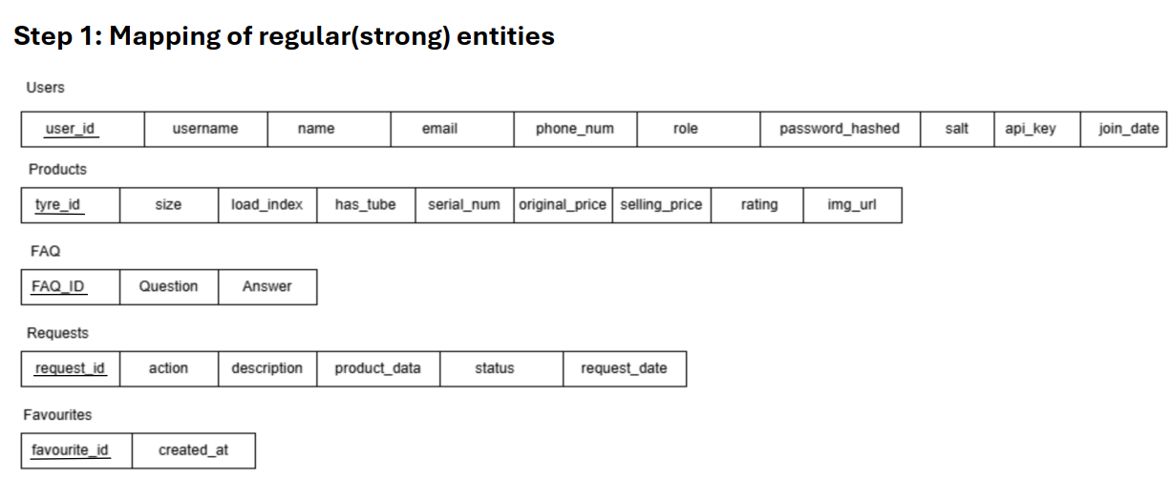

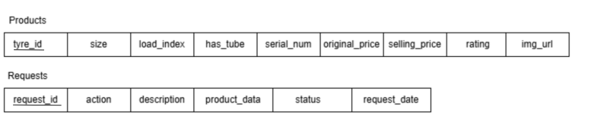
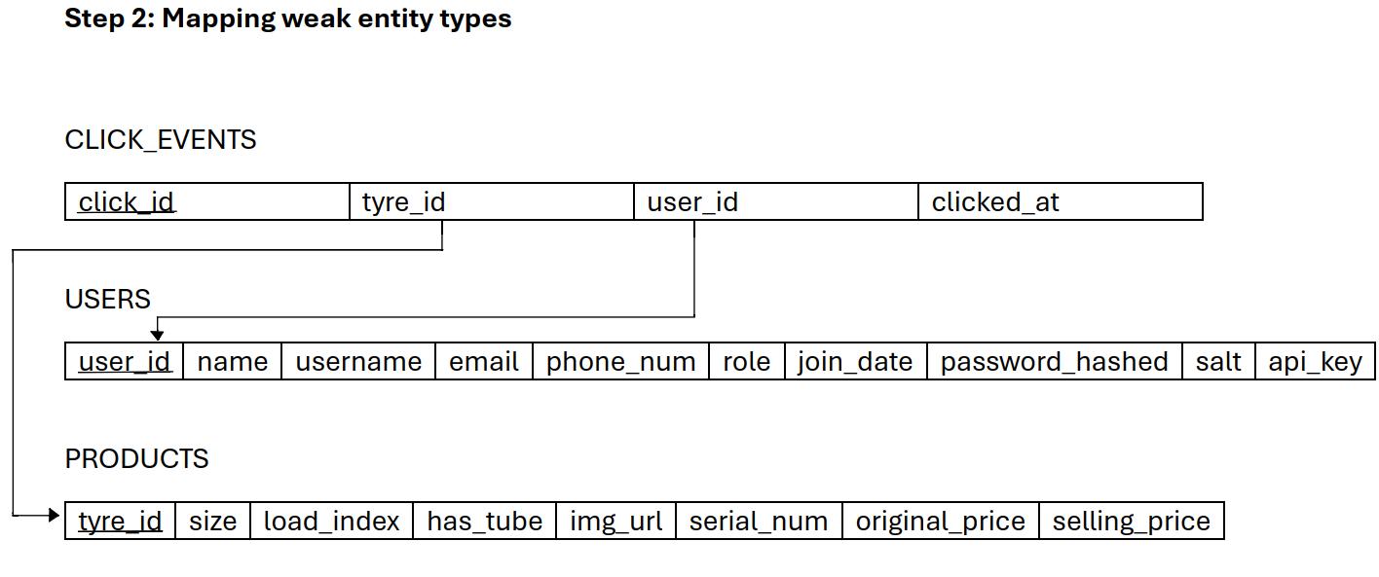
Our Relation Mapping – (Step 1-3)

Slide 5
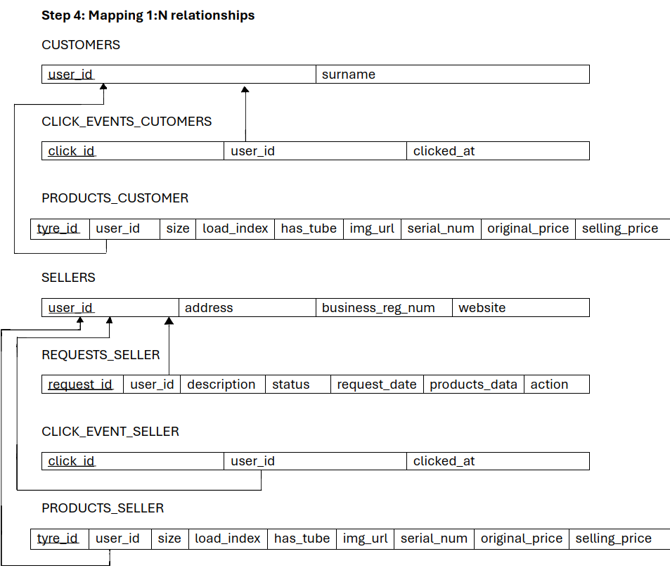
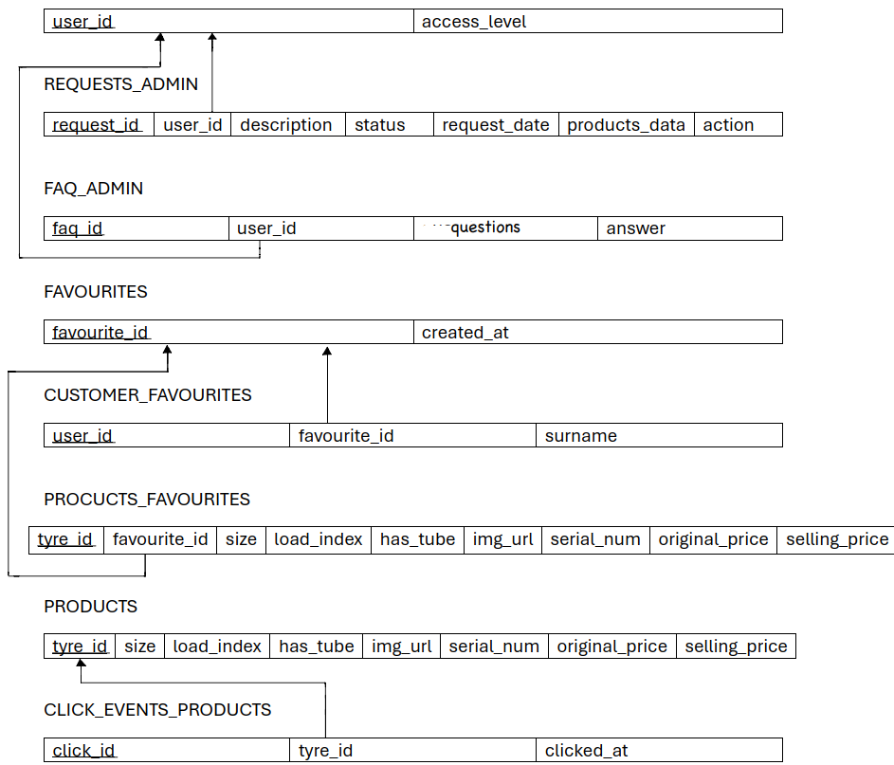
Our Relation Mapping – (Step 4)

Slide 6
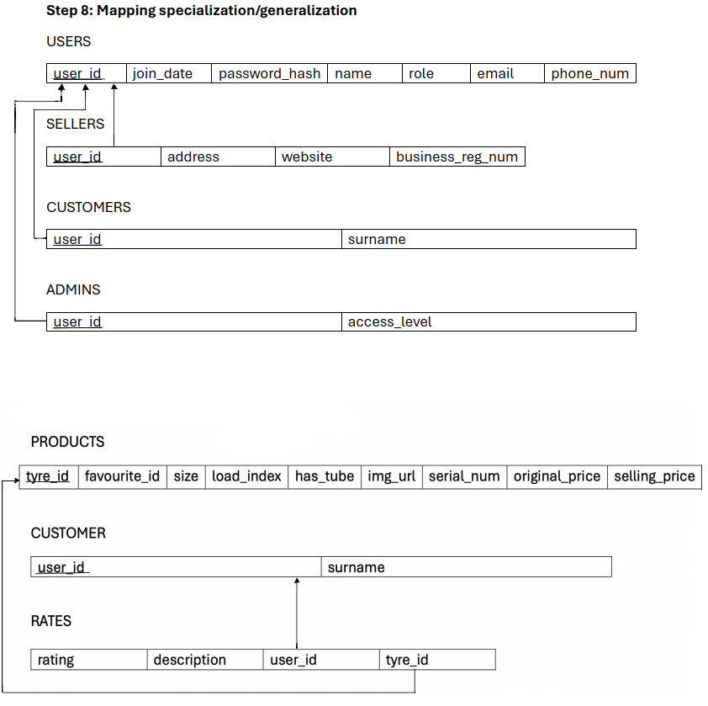
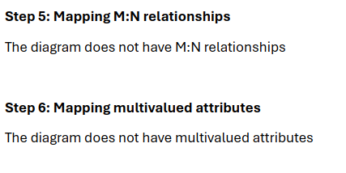


Our Relation Mapping – (Step 5 – 9)

Slide 7
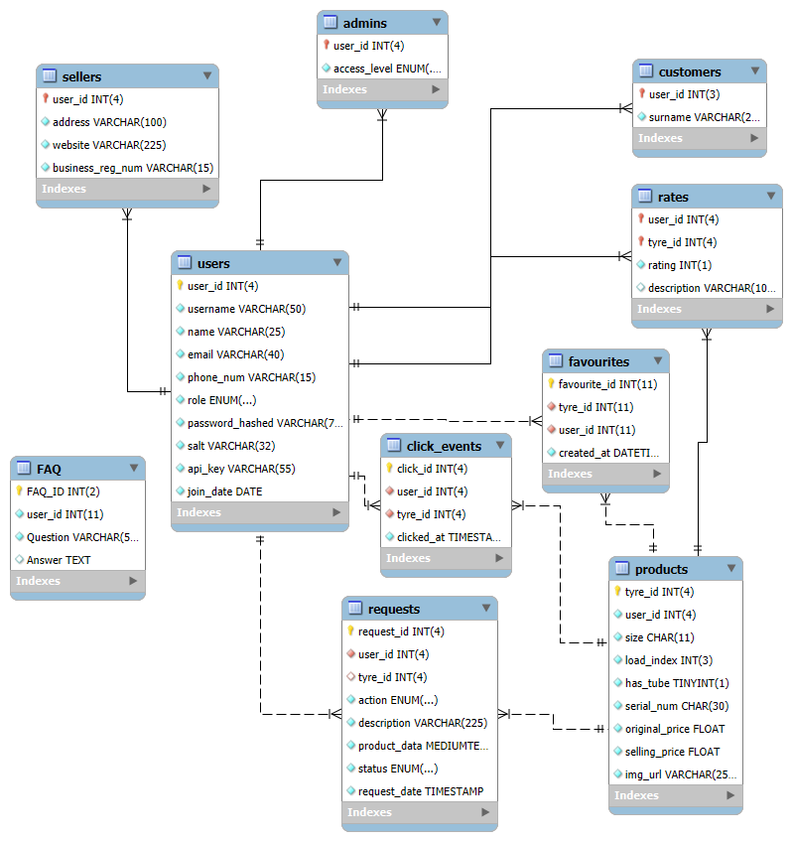
Task 4: Our Relation Schema

Slide 8
Task 6: Data

Slide 9
Task 7: Analyse and optimise

Slide 10
Task 8: Development

